Slide 1
Carbon and Molecular Diversity of Life
Chapter 4 (p. 58-67)

Slide 2
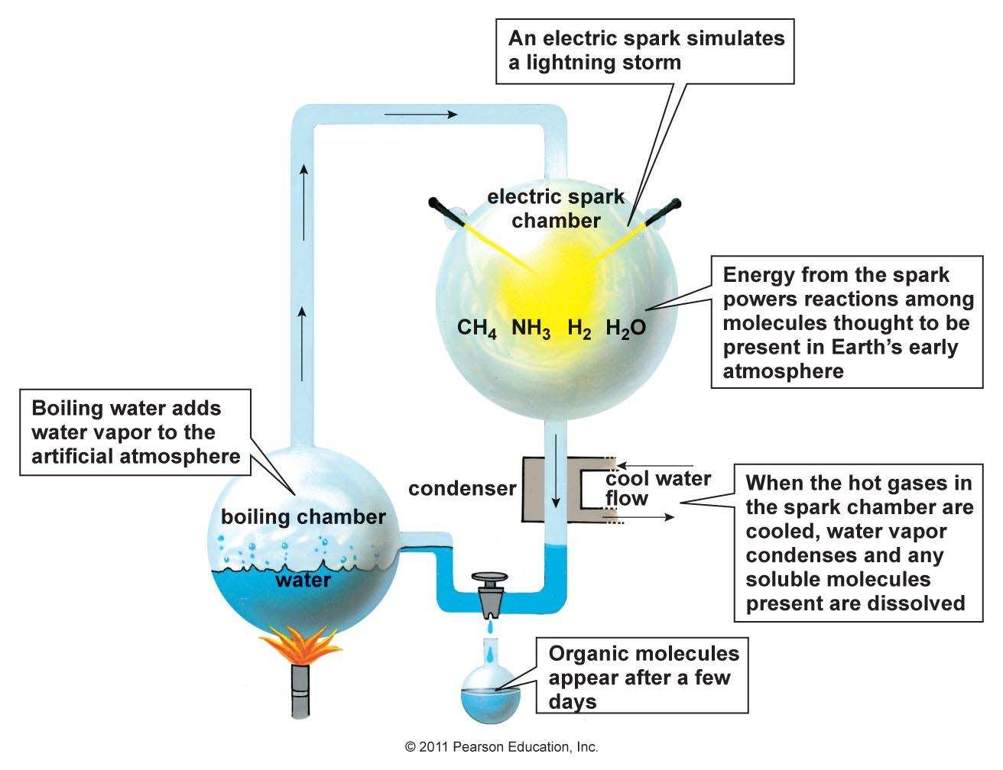
Miller & Urey Experiment

Slide 3
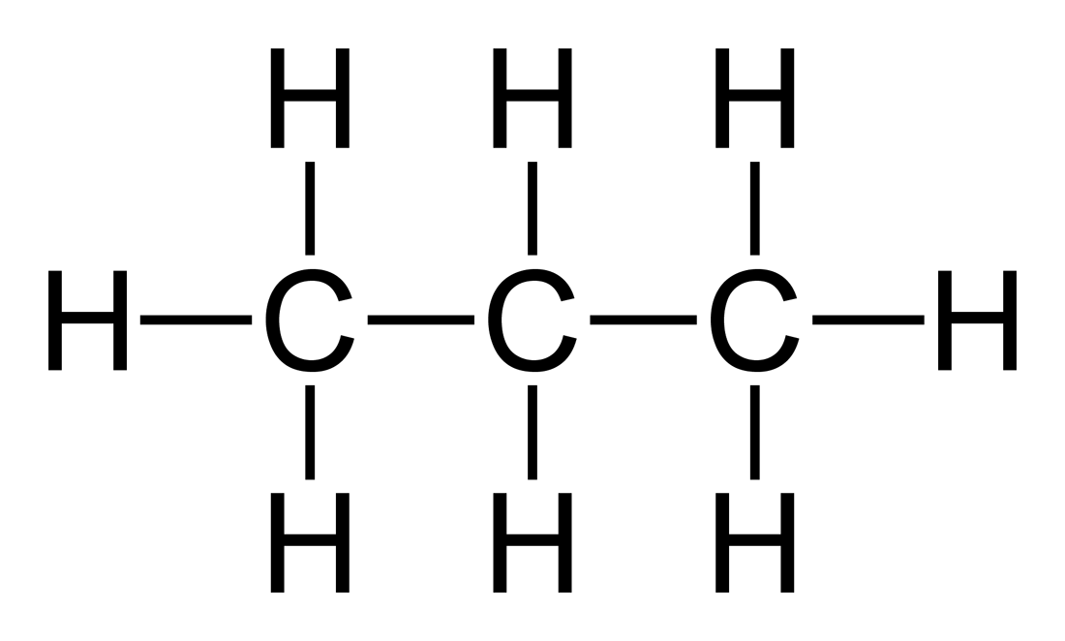
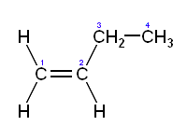
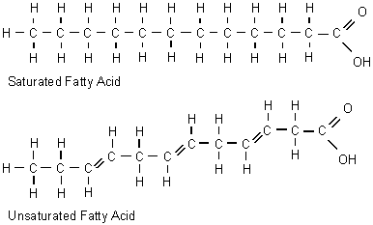
Variation in Carbon Skeletons
Length chain
Branching
Double bond position
Presence in rings

Slide 4
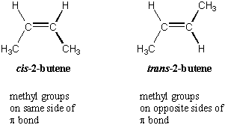
Isomers
Structural
Cis-trans

Slide 5
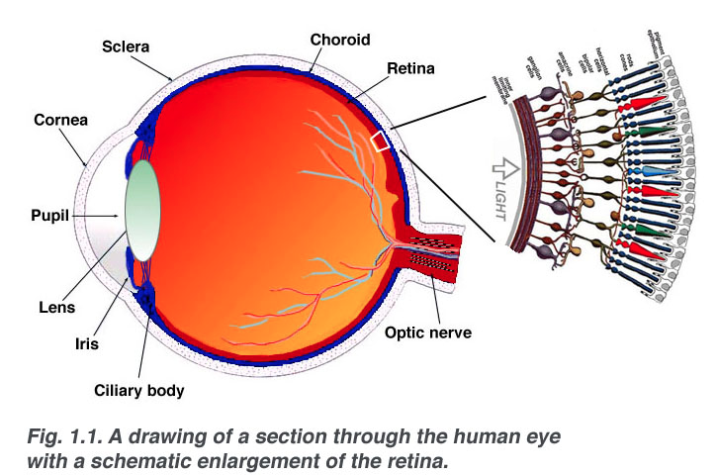

Slide 6
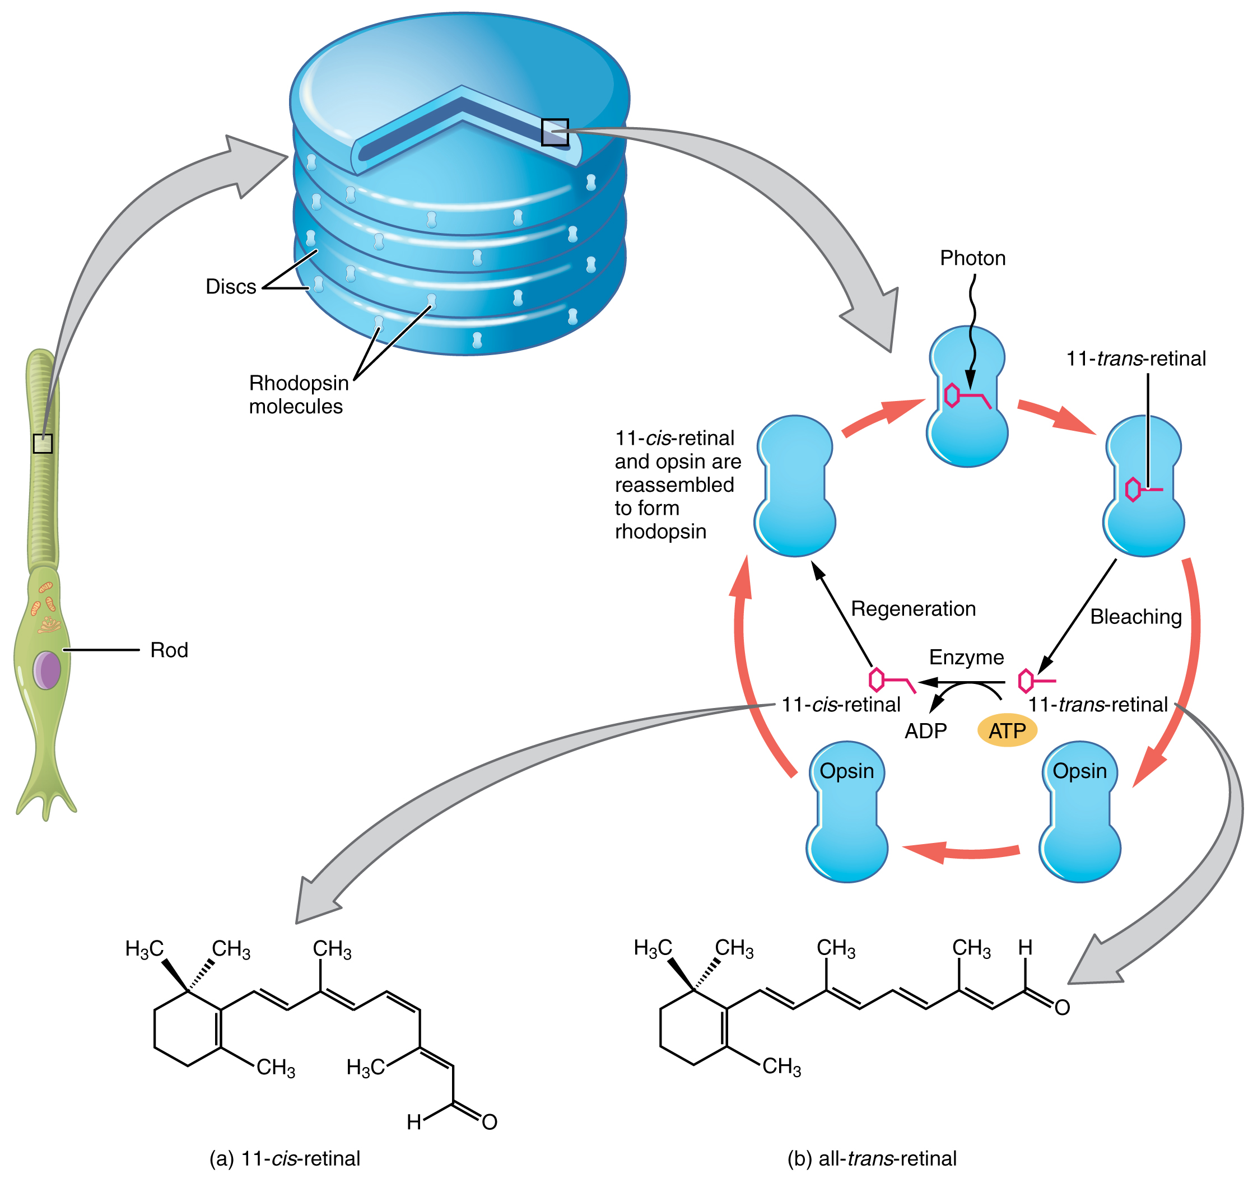

Slide 7
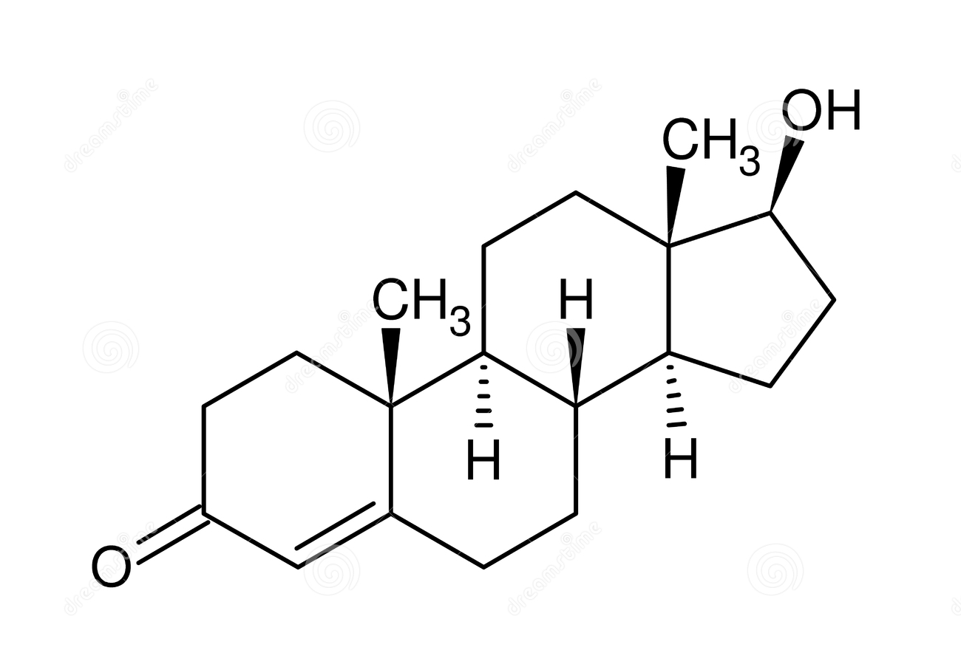
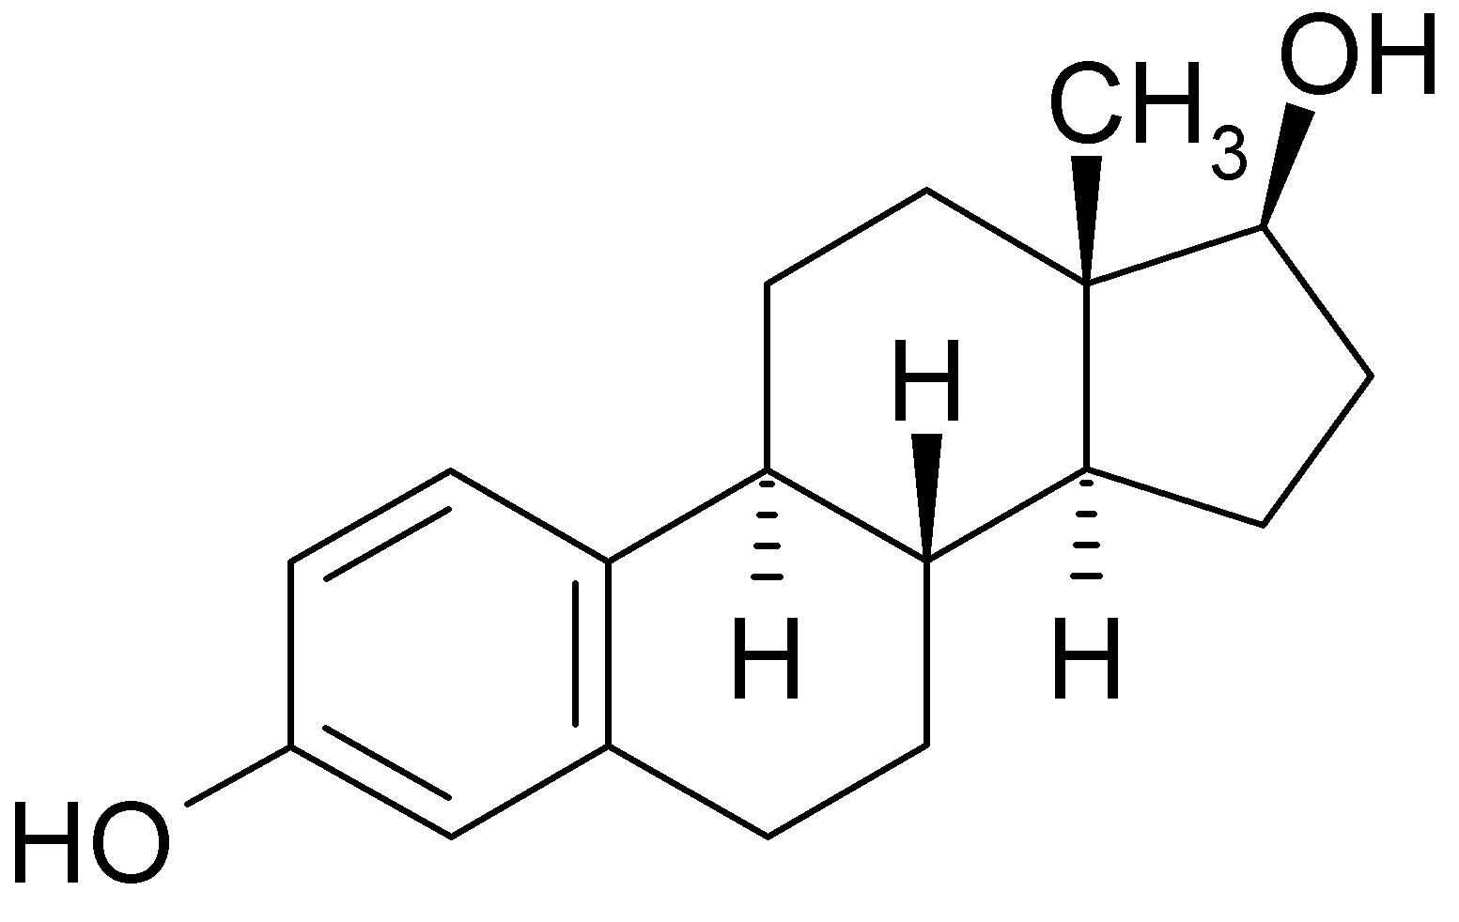
Functional Groups
Estradiol Testosterone

Slide 8
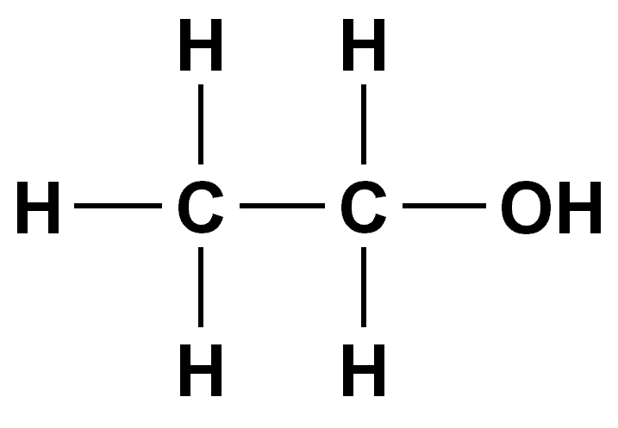
Hydroxyl
Ethanol

Slide 9
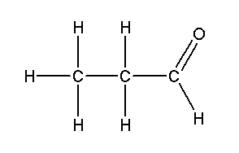
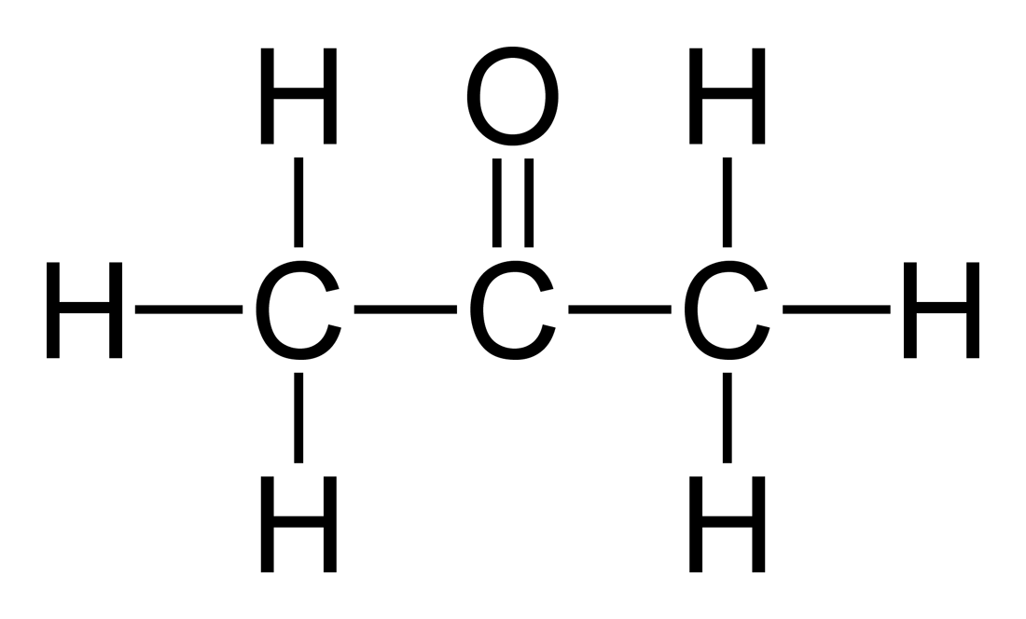
Carbonyl
Acetone Propanal

Slide 10
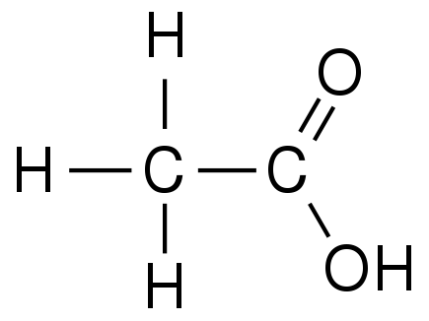
Carboxyl
Acetic acid

Slide 11
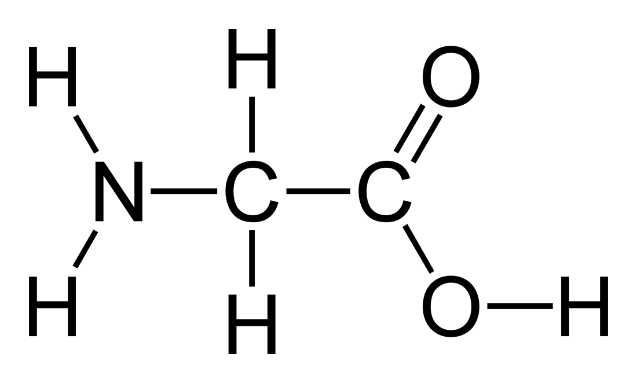
Amino
Glycine

Slide 12
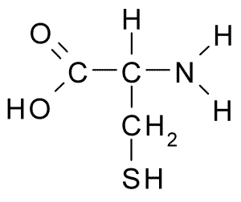
Sulfhydryl
Cysteine

Slide 13
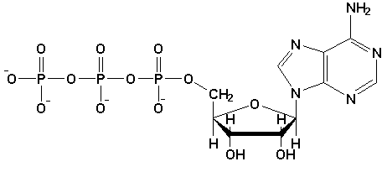
Phosphate
Adenosine triphosphate

Slide 14
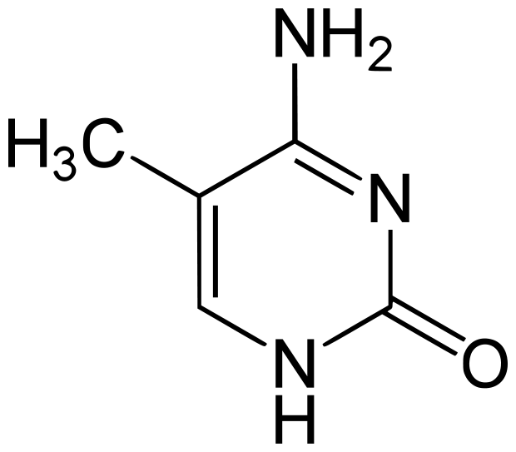
Methyl
5-Methyl cytosine

